Slide 1
Chapter 2: Algorithm Discovery and Design
BMM 105 Introduction to Computer Engineering, Fall 2018

Slide 2
Objectives
In this chapter, you will learn about
Representing algorithms
Examples of Algorithmic Problem Solving
Invitation to Computer Science, C++ Version, Fourth Edition
Notes:
This chapter develops the more fully the notions of algorithm and algorithmic problem solving
And applies these ideas to problems such searching lists, finding minima and maxima and matching pattens

Slide 3
Representing Algorithms
Natural language
  Language spoken and written in everyday life
  Problems with using natural language for algorithms
    Verbose
    Imprecise
      Relies on context and experiences to give precise meaning to a word or phase
Invitation to Computer Science, C++ Version, Fourth Edition
Notes:
How should represent algorithms, what notations should we use to express algorithms so that they are clear, precise and unambigious.
NLs can be extremely verbose, causing the results of algortihms to be rampling, unstructured and hard to follow.
A second problems is that NL is too rich in interpretation and meaning.
This permits different readers to intrepret the same sentence in totally different ways.

Slide 4
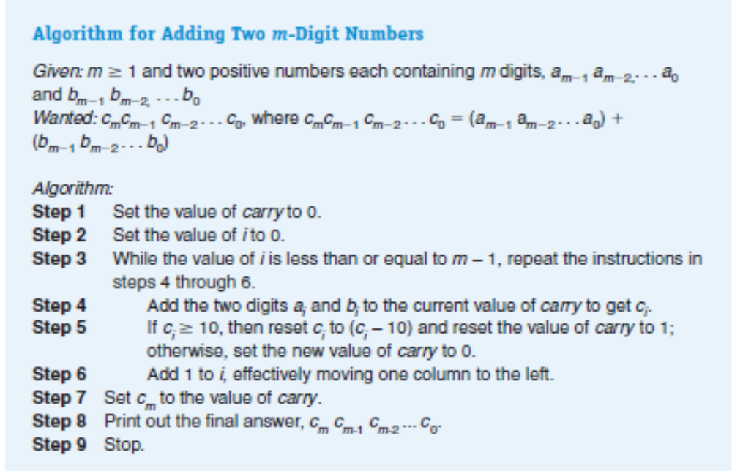
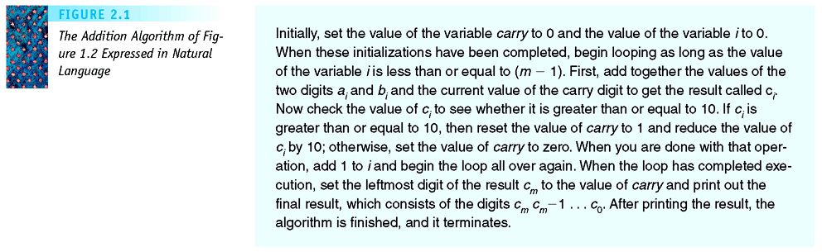
Figure 2.1
The Addition Algorithm of Figure 1.2 Expressed in Natural Language
Invitation to Computer Science, C++ Version, Fourth Edition

Slide 5
Representing Algorithms (continued)
High-level programming language
  Examples: C++, Java, Python
  Problem with using a high-level programming language for algorithms
    During the initial phases of design, we are forced to deal with detailed language issues
Invitation to Computer Science, C++ Version, Fourth Edition
Notes:
Such as punctuation, grammar, and syntax
We should be thinking and writing at highly abtracted level.

Slide 6
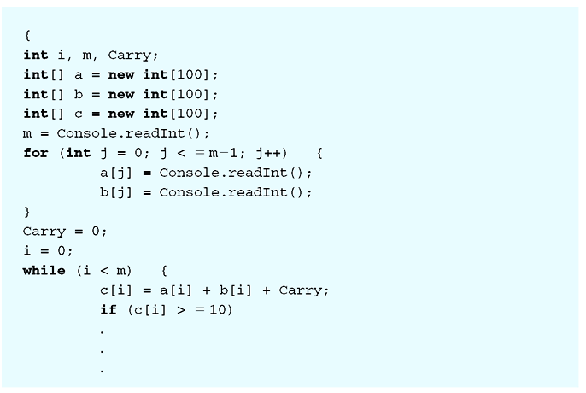
Figure 2.2
The Beginning of the Addition Algorithm of Figure 1.2 Expressed in a High-Level Programming Language
Invitation to Computer Science, C++ Version, Fourth Edition

Slide 7
Figure 1.2
Algorithm for Adding Two m-digit Numbers
Invitation to Computer Science, C++ Version, Fourth Edition

Slide 8
Pseudocode
English language constructs modeled to look like statements available in most programming languages
Steps presented in a structured manner (numbered, indented, and so on)
No fixed syntax for most operations is required
Invitation to Computer Science, C++ Version, Fourth Edition
Notes:
Most computer scientists use a notation called pseudocode to
That you can adapt it to your own personal way of thinking and problem solving .

Slide 9
Pseudocode (continued)
Less ambiguous and more readable than natural language
Emphasis is on process, not notation
Well-understood forms allow logical reasoning about algorithm behavior
Can be easily translated into a programming language
Invitation to Computer Science, C++ Version, Fourth Edition

Slide 10
Sequential Operations
Computation operations
  Example
    Set the value “variable” to “arithmetic expression”
  Variable
    Named storage location that can hold a data value
Invitation to Computer Science, C++ Version, Fourth Edition
Notes:
We will introduce a set of popular and easy-understand constructs for three types of algoritmic operations: sequential, conditional, and iterative
Our pseudocode must include instructions to carry out three basic sequential operations called computation, input, and output.
The instruction for performing a computation and saving the result looks like the following:
The operation evaluates the arithmetic expression, gets a results and stores that result in the variable.
Set the value of carry to 0:
First evaluate the arithmetic expression, whihc in this case is constant value 0, then store that result in the variable called carry. I carry had a previosu value, say 1, it is discarded and replaced by the new value 0, You can visualize the result of this operation as follows:
Set the value of Area to pi rsquare
Assuming that the variable r has been given a value by a previous intruction in the algorithm
İf r doesn not a value, an error condition occurs, because this instruction is not effectively computable and it cannot be completed.

Slide 11
Sequential Operations (continued)
Input operations
  To receive data values from the outside world
  Example
    Get a value for r, the radius of the circle
Output operations
  To send results to the outside world for display
  Example
    Print the value of Area
Invitation to Computer Science, C++ Version, Fourth Edition
Notes:
When the computing agent is a computer, communications with the outside world are done via the input/output equipment such as keyboard, screen, mouse, printer, hard drive .
However when designing algrorithms, we care only that data is provided when we request it and that results are issued for presentation

Slide 12
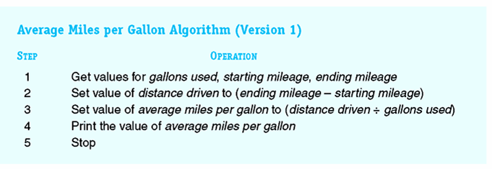
Figure 2.3
Algorithm for Computing Average Miles per Gallon
Invitation to Computer Science, C++ Version, Fourth Edition
Notes:
Using three sequential operations-computation, input, output, we can now write some simple but usefull algorithms.
This algorithm computes the average miles per gallon on a trip, when given as input the number of gallons used and starting and ending mileage readings
Write pseudocode of an algorithm that gets three data values x, y, and z as input and outputs the average of those three values.

Slide 13
Conditional and Iterative Operations
Sequential algorithm
  Also called straight-line algorithm
  Executes its instructions in a straight line from top to bottom and then stops
Control operations
  Conditional operations
  Iterative operations
Invitation to Computer Science, C++ Version, Fourth Edition
Notes:
Like the algorithm just you designed
Unfortunately, most real word problems are not straightline, they involve non-sequential operations such as branching and repetition
Our psedecode needs two additional statements to implement conditional and iteratiive operations. These two types of operations are called control operations.

Slide 14
Conditional and Iterative Operations (continued)
Conditional operations
  Ask questions and choose alternative actions based on the answers
  Example
    if x is greater than 25 then
    print x
    else
    print x times 100
Invitation to Computer Science, C++ Version, Fourth Edition
Notes:
The meaning of these statement as follows:
Evaluate the true/false condition to determine whether it is true or false
İf it is true, do first set of operations then skip the second set entirely
İf it is false, skip first set operations then do second set
Once the appropriate set of operations has been completed, follows next intruction.

Slide 15
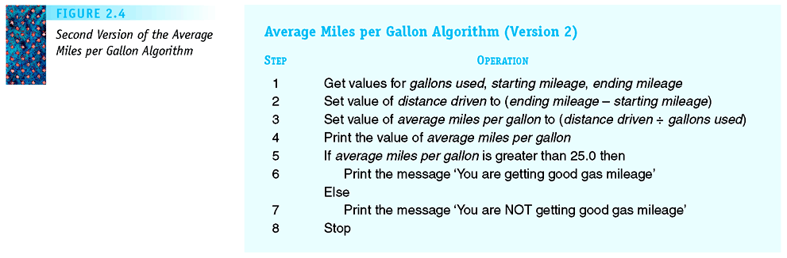
Figure 2.5
Second Version of the Average Miles per Gallon Algorithm
Invitation to Computer Science, C++ Version, Fourth Edition
Notes:
Write an if/then/else statement than sets the variable y to value 1 if x büyük eşit 0. İf x küçük 0, then the statement should set y to the value 2.
İf the value x is positive.
İf x is either zero or negative, your algorithm should not compute the average but should print the error message “bad data” instead.

Slide 16
Conditional and Iterative Operations (continued)
Iterative operations – while statement
  Perform “looping” behavior, repeating actions until a continuation condition becomes false
  Loop
    The repetition of a block of instructions
Invitation to Computer Science, C++ Version, Fourth Edition
Notes:
The algorithmic statement that we will use to express the idea of iteration, also called looping, is the while statement.

Slide 17
Conditional and Iterative Operations (continued)
Examples
    while j > 0 do
    set s to s + a_{j}
    set j to j - 1
    repeat
    print a_{k}
    set k to k + 1
    until k > n
Invitation to Computer Science, C++ Version, Fourth Edition
Notes:
This instruction first evaluates the “true/false condition” called the continuation condition to if it is true or false.
İf the condition is true, all operations from step i to step j are execute. This block of operations are called loop body. These operations are indented.
When the entire loop body has finished executing, the algorithm again evaluates the continuation condition. İf it is still truee, the the algorithm executes the entire loop body, statement i to j, again.
This looping process continues until the continuation condition evaluates to false.
If for some reason, the continuation condition never becomes false, we have the error, called an infinite loop.

Slide 18
Conditional and Iterative Operations (continued)
Components of a loop
  Continuation condition
  Loop body
Infinite loop
  The continuation condition never becomes false
  An error
Invitation to Computer Science, C++ Version, Fourth Edition

Slide 19
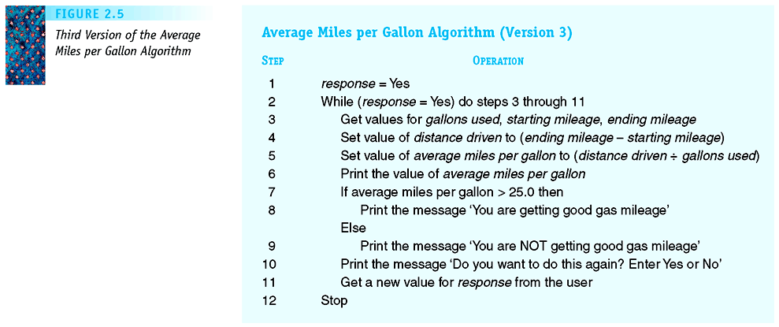
Figure 2.7
Third Version of the Average Miles per Gallon Algorithm
Invitation to Computer Science, C++ Version, Fourth Edition

Slide 20
Conditional and Iterative Operations (continued)
Pretest loop
  Continuation condition tested at the beginning of each pass through the loop
  It is possible for the loop body to never be executed
  While loop
Invitation to Computer Science, C++ Version, Fourth Edition

Slide 21
Conditional and Iterative Operations (continued)
Posttest loop
  Continuation condition tested at the end of loop body
  Loop body must be executed at least once
  Do/While loop
Invitation to Computer Science, C++ Version, Fourth Edition
Notes:
Tally hesapllama

Slide 22
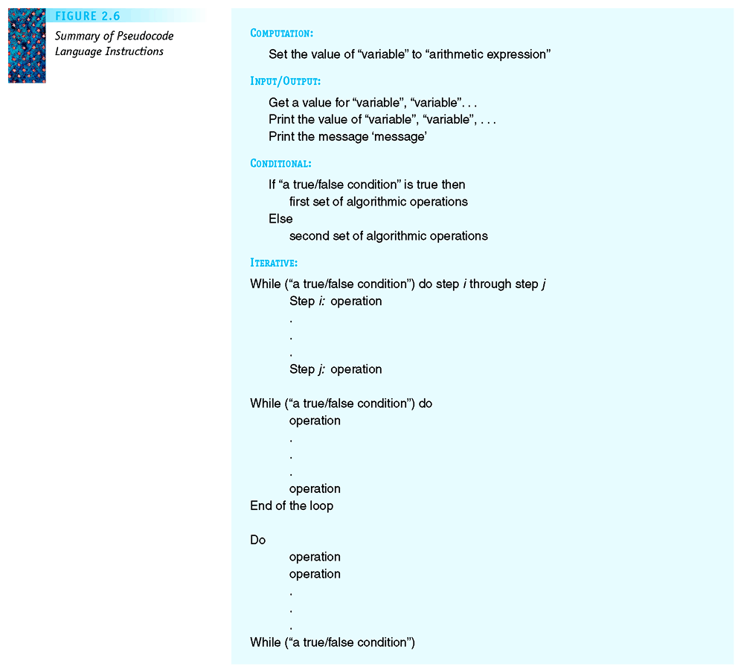

Figure 2.9
Summary of Pseudocode Language Instructions
Invitation to Computer Science, C++ Version, Fourth Edition

Slide 23
Examples of Algorithmic Problem Solving
Go Forth and Multiply: Multiply two numbers using repeated addition
Sequential search: Find a particular value in an unordered collection
Find maximum: Find the largest value in a collection of data
Pattern matching: Determine if and where a particular pattern occurs in a piece of text
Invitation to Computer Science, C++ Version, Fourth Edition

Slide 24
Example 1: Go Forth and Multiply
Task
  Implement an algorithm to multiply two numbers, a and b, using repeated addition
Algorithm outline
  Create a loop that executes exactly b times, with each execution of the loop adding the value of a to a running total
Invitation to Computer Science, C++ Version, Fourth Edition

Slide 25
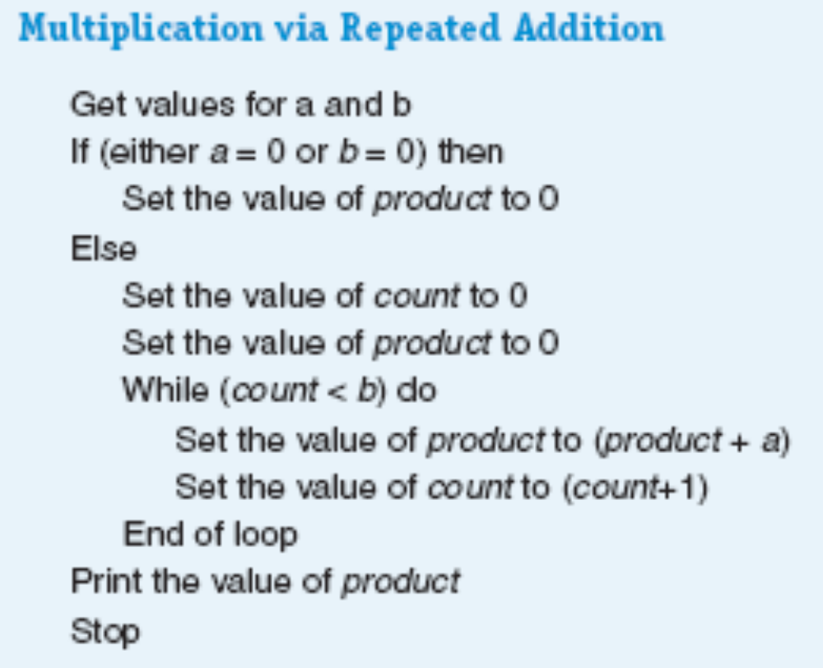
Figure 2.10
Algorithm for Multiplication via Repeated Addition
Invitation to Computer Science, C++ Version, Fourth Edition

Slide 26
Example 2: Looking, Looking, Looking
Task
  Find a particular person’s name from an unordered list of telephone subscribers
Algorithm outline
  Start with the first entry and check its name, then repeat the process for all entries
Invitation to Computer Science, C++ Version, Fourth Edition

Slide 27
Example 2: Looking, Looking, Looking (continued)
Algorithm discovery
  Finding a solution to a given problem
Naïve sequential search algorithm
  For each entry, write a separate section of the algorithm that checks for a match
  Problems
    Only works for collections of exactly one size
    Duplicates the same operations over and over
Invitation to Computer Science, C++ Version, Fourth Edition

Slide 28
Example 2: Looking, Looking, Looking (continued)
Correct sequential search algorithm
  Uses iteration to simplify the task
  Refers to a value in the list using an index (or pointer)
  Handles special cases (such as a name not found in the collection)
  Uses the variable Found to exit the iteration as soon as a match is found
Invitation to Computer Science, C++ Version, Fourth Edition

Slide 29
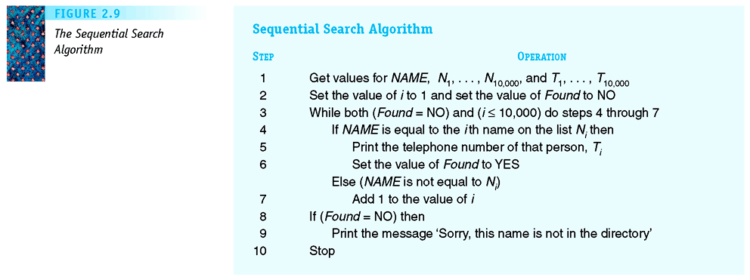
Figure 2.13
The Sequential Search Algorithm
Invitation to Computer Science, C++ Version, Fourth Edition

Slide 30
Example 2: Looking, Looking, Looking (continued)
The selection of an algorithm to solve a problem is greatly influenced by the way the data for that problem is organized
Invitation to Computer Science, C++ Version, Fourth Edition
Notes:
Because our telephone book was not alphabetized, we really had no choice in the design of a search algorithm.

Slide 31
Example 3: Big, Bigger, Biggest
Task
  Find the largest value from a list of values
Algorithm outline
  Keep track of the largest value seen so far (initialized to be the first in the list)
  Compare each value to the largest seen so far, and keep the larger as the new largest
Invitation to Computer Science, C++ Version, Fourth Edition

Slide 32
Example 3: Big, Bigger, Biggest (continued)
Once an algorithm has been developed, it may itself be used in the construction of other, more complex algorithms
Library
  A collection of useful algorithms
  An important tool in algorithm design and development
Invitation to Computer Science, C++ Version, Fourth Edition

Slide 33
Example 3: Big, Bigger, Biggest (continued)
Find Largest algorithm
  Uses iteration and indices as in previous example
  Updates location and largest so far when needed in the loop
Invitation to Computer Science, C++ Version, Fourth Edition

Slide 34
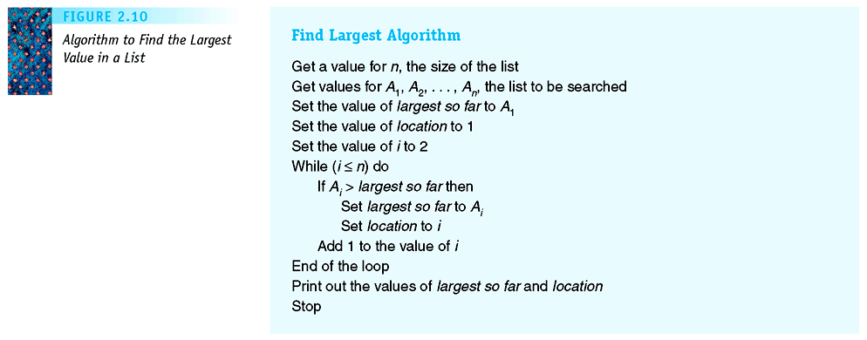
Figure 2.14
Algorithm to Find the Largest Value in a List
Invitation to Computer Science, C++ Version, Fourth Edition

Slide 35
Example 4: Meeting Your Match
Task
  Find if and where a pattern string occurs within a longer piece of text
Algorithm outline
  Try each possible location of pattern string in turn
  At each location, compare pattern characters against string characters
Invitation to Computer Science, C++ Version, Fourth Edition

Slide 36
Example 4: Meeting Your Match (continued)
Abstraction
  Separating high-level view from low-level details
  Key concept in computer science
  Makes difficult problems intellectually manageable
  Allows piece-by-piece development of algorithms
Invitation to Computer Science, C++ Version, Fourth Edition
Notes:
Example 4: Meeting Your Match (continued)

Slide 37
Example 4: Meeting Your Match (continued)
Top-down design
  When solving a complex problem
    Create high-level operations in the first draft of an algorithm
    After drafting the outline of the algorithm, return to the high-level operations and elaborate each one
    Repeat until all operations are primitives
Invitation to Computer Science, C++ Version, Fourth Edition
Notes:
Example 4: Meeting Your Match (continued)

Slide 38
Example 4: Meeting Your Match (continued)
Pattern-matching algorithm
  Contains a loop within a loop
    External loop iterates through possible locations of matches to pattern
    Internal loop iterates through corresponding characters of pattern and string to evaluate match
Invitation to Computer Science, C++ Version, Fourth Edition
Notes:
Example 4: Meeting Your Match (continued)

Slide 39
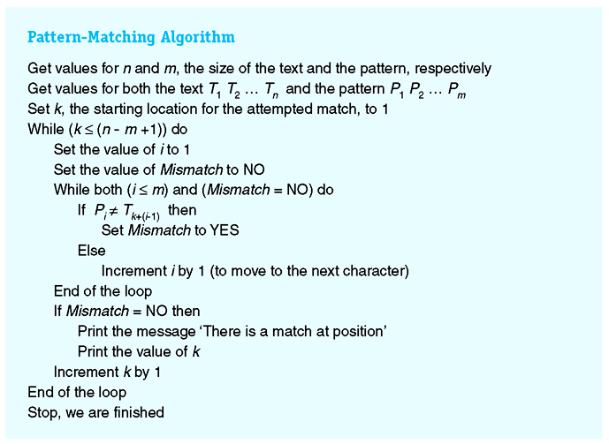
Figure 2.16
Final Draft of the Pattern-Matching Algorithm
Invitation to Computer Science, C++ Version, Fourth Edition
Notes:
Example 4: Meeting Your Match (continued)

Slide 40
Summary
Algorithm design is a first step in developing an algorithm
Algorithm design must
  Ensure the algorithm is correct
  Ensure the algorithm is sufficiently efficient
Pseudocode is used to design and represent algorithms
Invitation to Computer Science, C++ Version, Fourth Edition
Notes:
Example 4: Meeting Your Match (continued)

Slide 41
Summary
Pseudocode is readable, unambiguous, and able to be analyzed
Algorithm design is a creative process; uses multiple drafts and top-down design to develop the best solution
Abstraction is a key tool for good design
Invitation to Computer Science, C++ Version, Fourth Edition

